Slide 1


Enhanced Low SNR Radio Signal Classification using Deep Learning
Final Presentation
AI Wireless
M Farhan Tandia (方爾漢) (0860814),
Ivan Surya H（胡云輝) (0860812)
Team 13
National Chiao Tung University, Taiwan

Slide 2
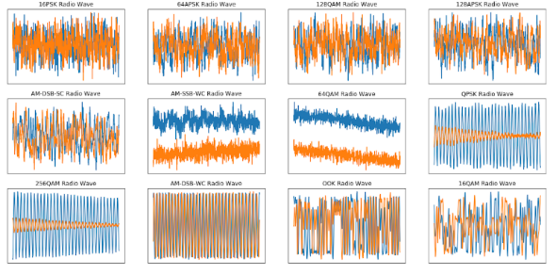

BACKGROUND
Signal modulation used to transmit a signal is important. Spectrum interference monitoring, radio fault detection, dynamic spectrum access, etc.
Traditional signal classification need to extract some features. Fourier Transform, SIFT, MFCC, or another handcrafting method using statistical modulation features.
Defence Application Radio signals may reveal vital information regarding the detection, localization, and identification of an opponent.

Slide 3



PROBLEM STATEMENTS
What is the new state of the art of deep learning needs to be chosen and suitable for radio signal classification?
How we could make use of a large dataset to classify the RAW signal using the new state of the art of deep learning network?
How we could do a benchmark comparison with the previous state of the art method?
Notes:
Problems
What are the problems that you are trying to solve?
Why are the problems important?

Slide 4
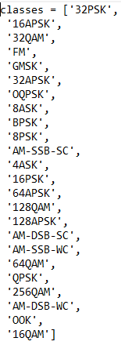
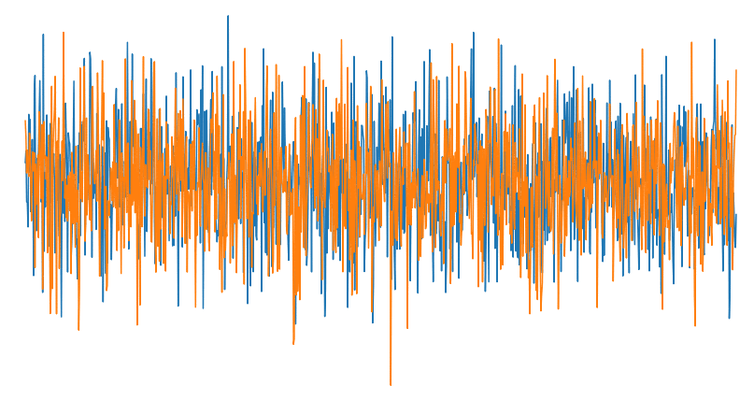
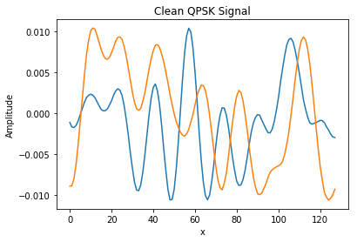
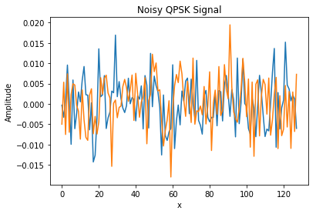
CHALLENGES
In the image below, we can see how drastically noise can affect our ability to recognize a signal.
We should be able to classify signals both in low SNR and high SNR.
We use the DeepSig Radio Signal Dataset, this dataset is pretty large (18GB). We will use 1.5 Million variation of signal modulation with respect to the SNR value.
DeepSig Dataset ,2018
High VS Low
SNR
Notes:
In reality, the signal is always not ideal and combined with unwanted signal that is considered as noise.
A clean signal will have a high SNR and a noisy signal will have a low SNR.
Challenges
What are the limitation of current approaches?
What are the differences between these prior approaches and your proposed?

Slide 5
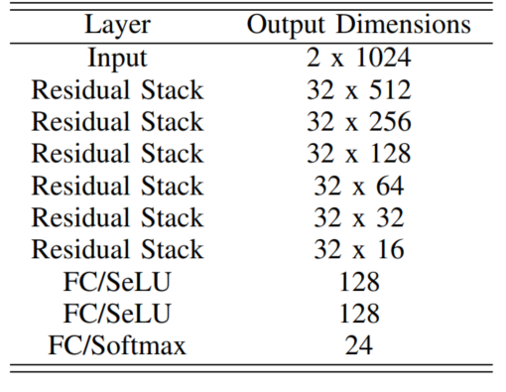
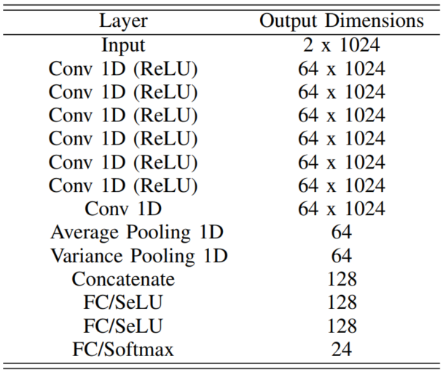
PREVIOUS METHOD
FOCUS ON HIGH SNR
Baseline ResNet Architecture [1]
Maximum Accuracy : 93.7 %
X-Vector Architecture [2]
Maximum Accuracy : 98%
[1] T. J. O’Shea, T. Roy and T. C. Clancy, "Over-the-Air Deep Learning Based Radio Signal Classification," in IEEE Journal of Selected Topics in Signal Processing 2018
[2] Harper, Clayton A., et al. "Enhanced Automatic Modulation Classification using Deep Convolutional Latent Space Pooling." ASILOMAR Conference on Signals, Systems, and Computers. 2020.

Slide 6
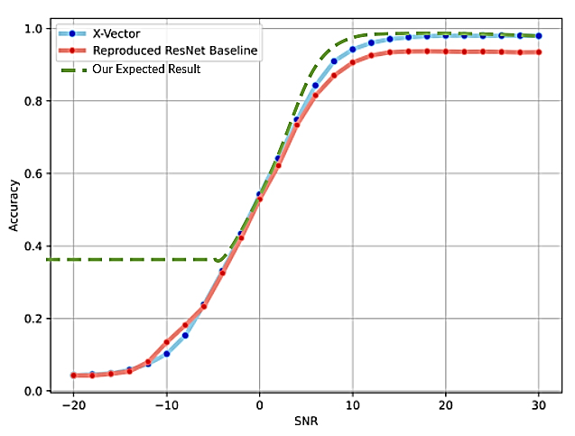
GOALS
Get higher accuracy in lower SNR value.
Design a new deep learning architecture and try to get the comparable results in terms of accuracy with state of the art or even better.
End-to-end Deep Learning Model System (using only RAW signal).
Get a comparable result
on High SNR Classification
Accuracy.
Increase Low SNR
Classification Accuracy
Notes:
It will indicate that our model is robust under the noisy signal modulation.
Goal
What is your key concept and its unique and novelty? What are the expected advantages?
the X-Vector approach begins to outpace the ResNet model beginning around a 6dB SNR value.

Slide 7
PROPOSED METHOD
Input Signal
High SNR Model
Low SNR Model
Residual Stack
Transformer Block
Fully Connected
Fully Connected
Max
Output Class
Notes:
Goal
What is your key concept and its unique and novelty?
What are the expected advantages?

Slide 8
High SNR Model ResNet Modified
Optimizer : SGD
Optimizer : LazyAdam
Layer | Output Dimension
Input | 2 x 1024
Residual Stack | 32 x 512
Residual Stack | 32 x 256
Residual Stack | 32 x 128
Residual Stack | 32 x 64
Residual Stack | 32 x 32
Residual Stack | 32 x 16
FC/SeLU - Alpha Dropout | 128
FC/SeLU - Alpha Dropout | 128
FC/Softmax | 24
Layer | Output Dimension
Input | 2 x 1024
Residual Stack | 32 x 512
Residual Stack | 32 x 256
Residual Stack | 64 x 128
Residual Stack | 64 x 64
Residual Stack | 32 x 32
Residual Stack | 32 x 16
FC/SeLU - Dropout | 128
FC/SeLU - Dropout | 128
FC/Softmax | 24

Slide 9
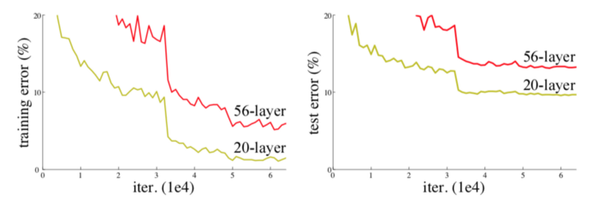
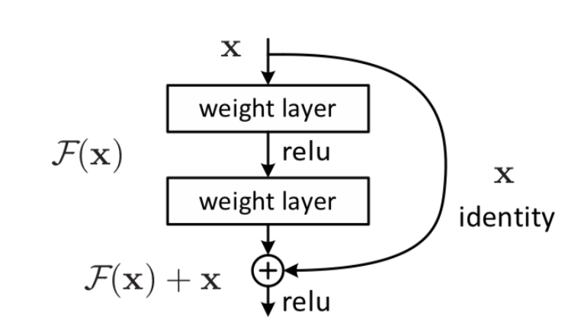
High SNR Model Residual Stack Explained
One of the major benefits of a very deep network is that it can represent very complex functions.
However, a huge barrier to training them is vanishing gradients: Gradient signal that goes to zero quickly, thus making gradient descent prohibitively slow
Two takeaways from residual block:
Adding additional / new layers would not hurt the model’s performance as regularisation will skip over them if those layers were not useful.
If the additional / new layers were useful, even with the presence of regularisation, the weights or kernels of the layers will be non-zero and model performance could increase slightly.
Solution : Residual Block / Identity Block

Slide 10
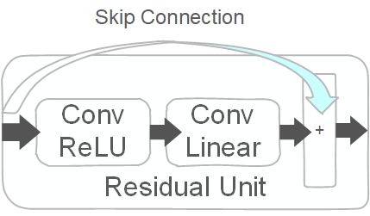
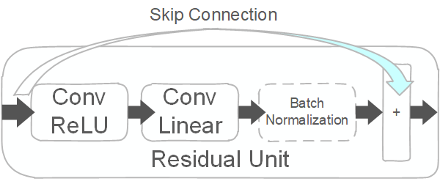
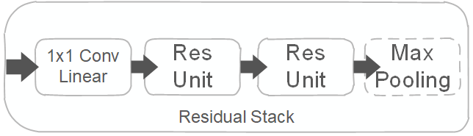
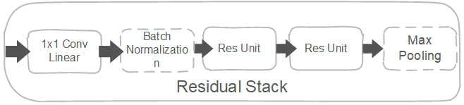
High SNR Model ResNet Modified
Baseline Residual Stack Composition
Modified Residual Stack Composition

Slide 11
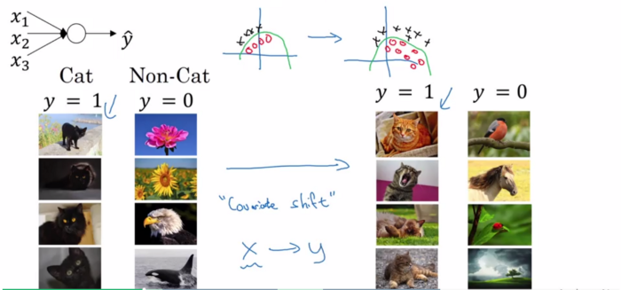
High SNR Model Batch Normalization Explained
Two takeaways from batch normalization:
We can use higher learning rates because batch normalization makes sure that there’s no activation that’s gone really high or really low.
It reduces overfitting because it has a slight regularization effects. Similar to residual stack, it adds some noise to each hidden layer’s activations. Therefore, if we use batch normalization, we will use less residual stack, which is a good thing because we are not going to lose a lot of information.
Batch normalization reduces the amount by what the hidden unit values shift around (covariance shift)
Example: We train our data on only black cats’ images. So, if we now try to apply this network to data with colored cats, it is obvious; we’re not going to do well. Batch normalization will help this kind of problem

Slide 12
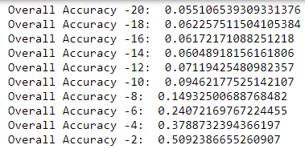
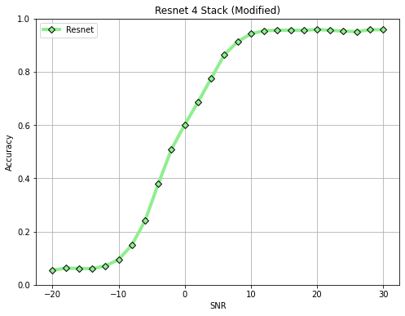
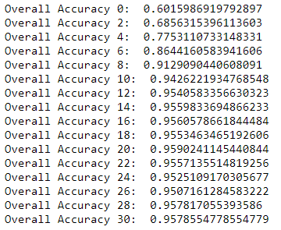
Key Result High SNR (ResNet)
Maximum Accuracy : 95.9 % Baseline Max Accuracy : 93%

Slide 13


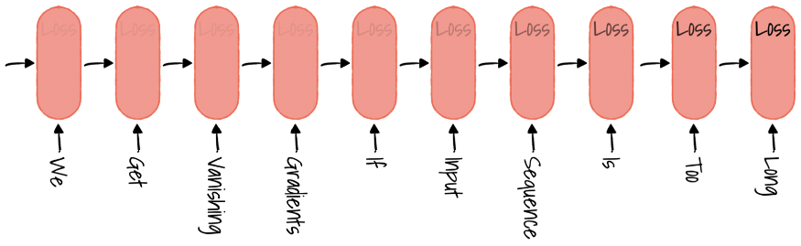
Low SNR Model
The Search for time-series deep learning based model
1
2
Recurrent Neural Network, 1986 (Sequential processing)
Slow training time and inference testing time
Vanishing gradient (after 100 words or sequence)
Long-Short Term Memory, 1997 (RNN Based model)
Even Slower training time and inference testing time (more complex)
Vanishing gradient still occurred (after 300 sequences)
Context of data is not captured well (fix-length vector)
“The dog bit Johnny” and “Johnny bit the dog.”

Slide 14
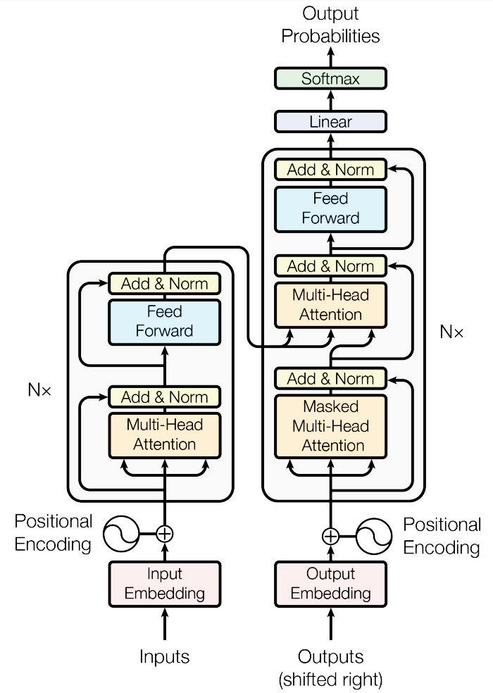
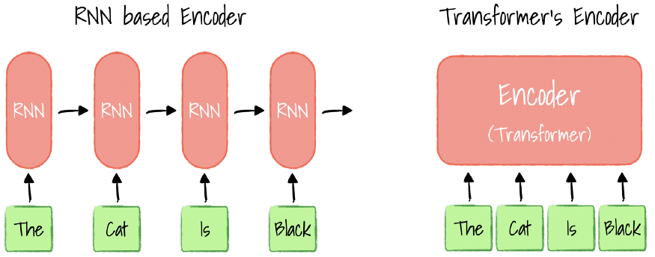
Low SNR Model
(Transformer ,2017)
Decoder
Encoder
Way faster training time and inference testing time (parallelization)
Solved vanishing gradient problem (encoder-decoder attention)
Context of data is well captured (positional encoding & self attention mechanism)
[3] Vaswani, A.; Shazeer, N.; Parmar, N.; Uszkoreit, J.; Jones, L.; Gomez, A. N.; Kaiser, Ł. & Polosukhin, I. (2017), Attention is all you need, in 'Advances in Neural Information Processing Systems' , pp. 5998--6008 .
input True Data
input True Data
http://jalammar.github.io/illustrated-transformer/
Notes:
use parallelization for sequential data

Slide 15
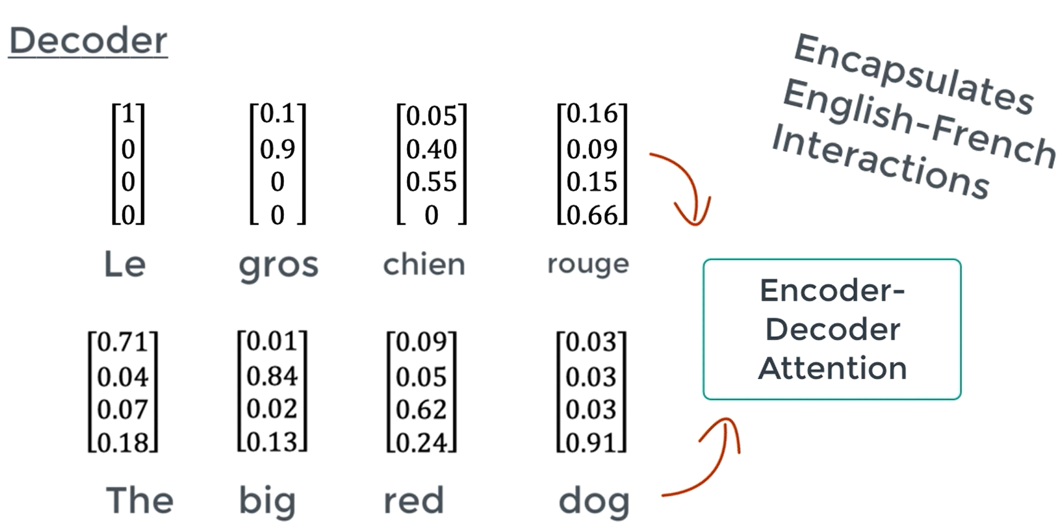
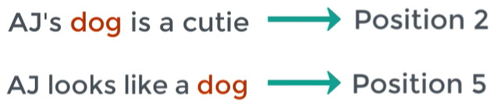
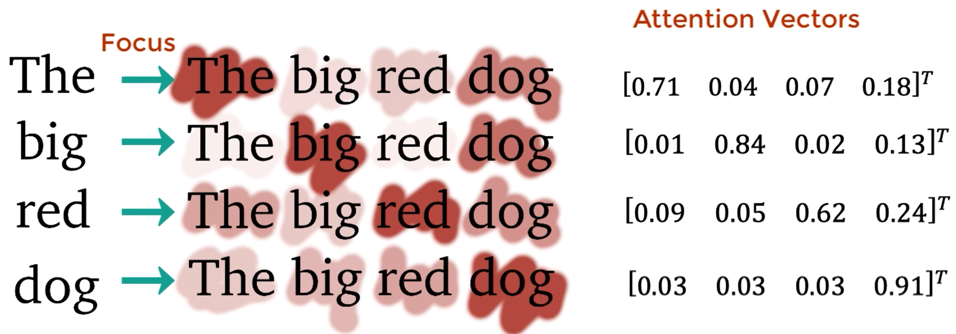
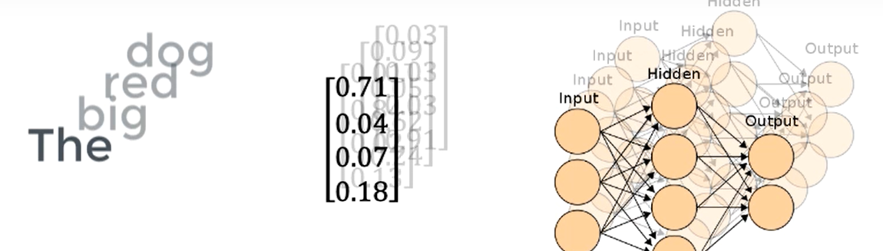
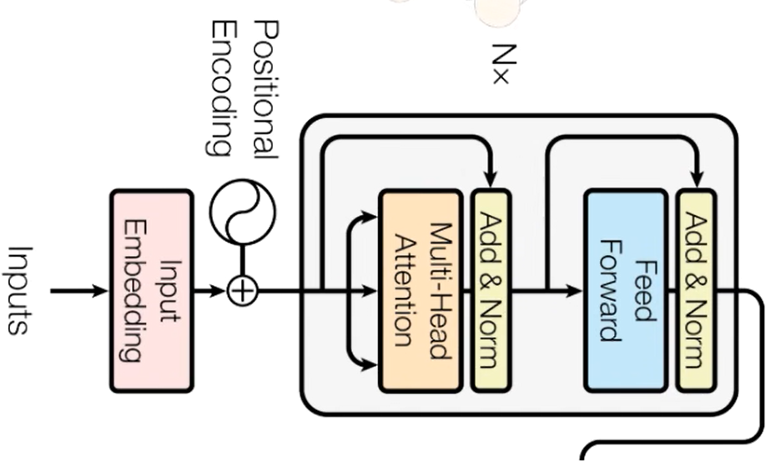
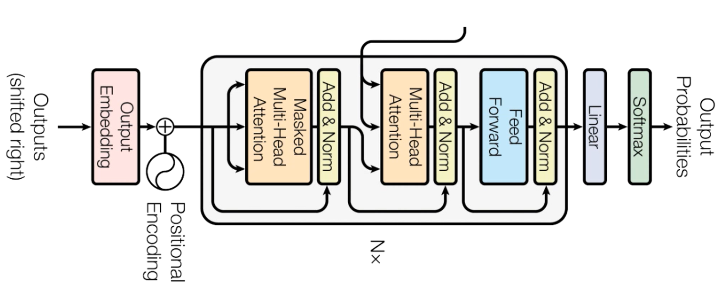
Transformer ,2017
3. Multi Head Attention (Decoder) - Encoder Decoder Attention determine how related each sequence vector is with respect to each other.
Positional Encoding : vector that gives context based on position of word in sentence
2. Multi-Head Attention (Encoder) : What part of the input should we focus on? How relevant is the i-th word in the sentence relevant to other words in the same sentence.
4. Feed Forward net : to transform the attention vectors into a form that is digestible by the next encoder/decoder block
Encoder
Decoder

Slide 16
Low SNR Model
(Transformer ,2017)
Decoder
Optimizer : Lazy Adam
Encoder
Layer | Output Dimension
Input | 2 x 1024
Transformer Block Feed forward : 256 nodes | 2 x 1024
Global Average Pooling | 1024
Batch Normalization | 1024
Alpha Dropout (0.3) | 1024
FC/SeLU - Alpha Dropout (0.2) | 128
FC/SeLU - Alpha Dropout (0.2) | 128
FC/Softmax | 24
[3] Vaswani, A.; Shazeer, N.; Parmar, N.; Uszkoreit, J.; Jones, L.; Gomez, A. N.; Kaiser, Ł. & Polosukhin, I. (2017), Attention is all you need, in 'Advances in Neural Information Processing Systems' , pp. 5998--6008 .
input True Data
input True Data
http://jalammar.github.io/illustrated-transformer/

Slide 17
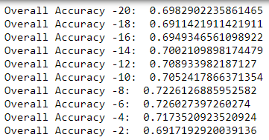
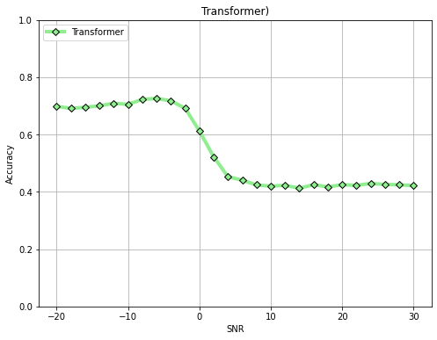
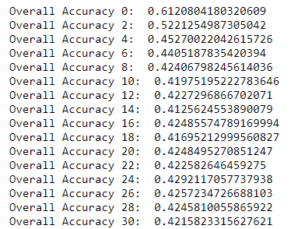
Key Result Low SNR (Transformer)
Maximum Accuracy : 72.6 % Baseline Max Accuracy : 20%

Slide 18
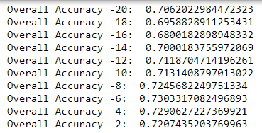
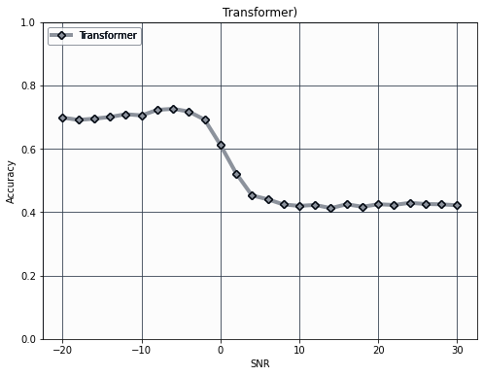
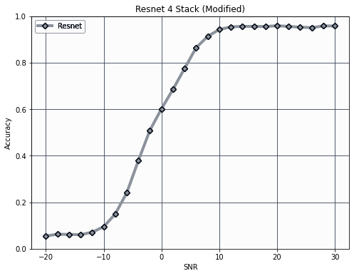
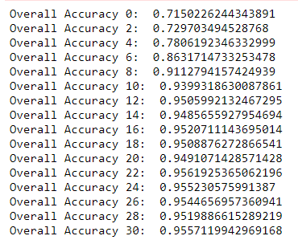
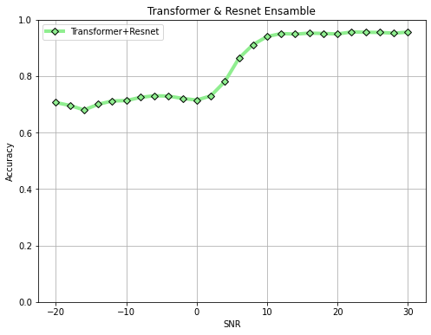
Key Result (Ensemble)
Low SNR Model
using Transformer
High SNR Model using ResNet Modified
Ensembled

Slide 19
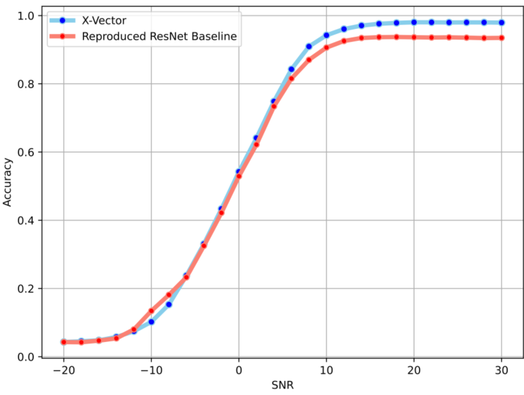
Comparison with SOTA (Accuracy)
High SNR (maximum accuracy)
X-Vector : 98%
Resnet Baseline : 93.7%
Resnet Modified (Ours) : 95 %
Low SNR (-20,0)
X-Vector : 17%
Resnet Baseline : 14%
Transformer (Ours) : 70.0 %

Slide 20
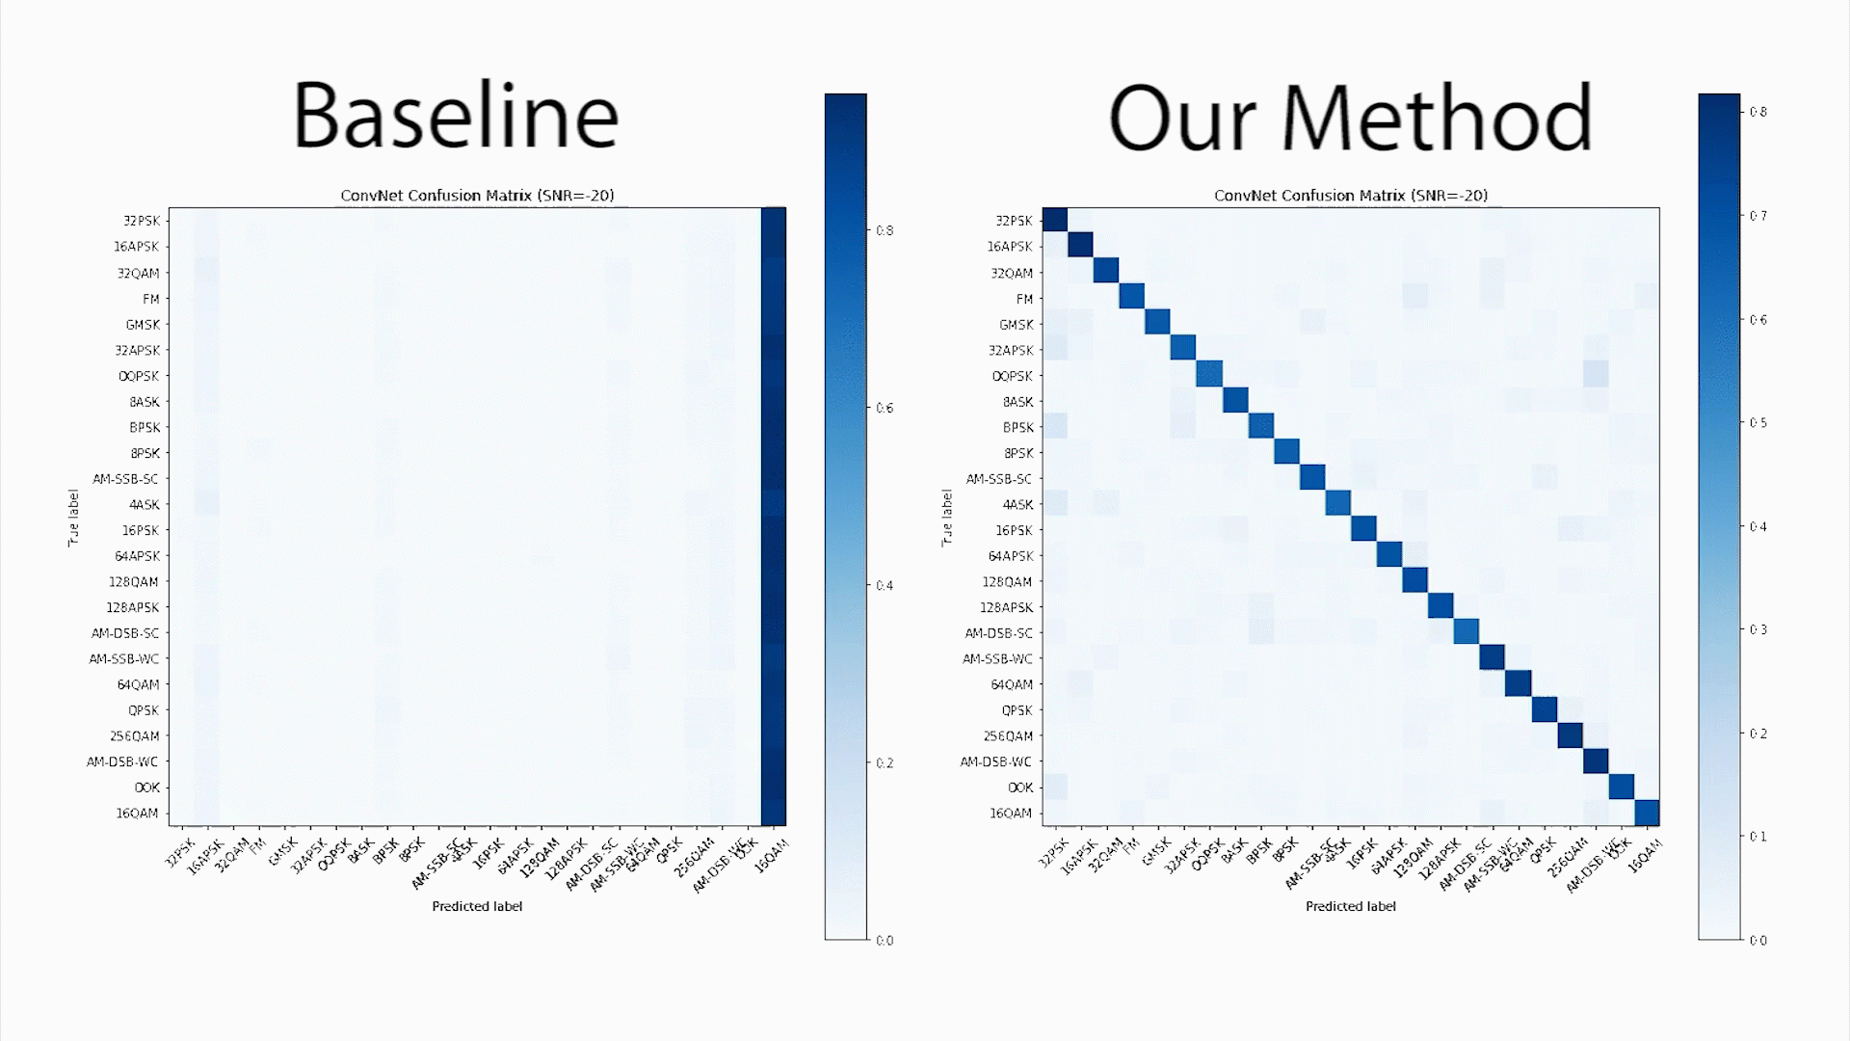
Comparison with SOTA (Confusion Matrix)

Slide 21

CONCLUSION
We show that using ensemble method our classifier can learn the signal not only for high SNR but also low SNR.
Transformer model can achieve up to 70% accuracy at low SNR values which is a big improvement in comparison with previous approach.
Our modified ResNet get higher accuracy than the baseline model and comparable with state-of-the-art.
We successfully make a new end-to-end deep learning model for modulation signal classification.

Slide 22
Thank you
☺

Slide 23
References
T. J. O’Shea, T. Roy and T. C. Clancy, "Over-the-Air Deep Learning Based Radio Signal Classification," in IEEE Journal of Selected Topics in Signal Processing, vol. 12, no. 1, pp. 168-179, Feb. 2018, doi: 10.1109/JSTSP.2018.2797022.
Harper, Clayton A., et al. "Enhanced Automatic Modulation Classification using Deep Convolutional Latent Space Pooling." ASILOMAR Conference on Signals, Systems, and Computers. 2020.
Vaswani, A.; Shazeer, N.; Parmar, N.; Uszkoreit, J.; Jones, L.; Gomez, A. N.; Kaiser, Ł. & Polosukhin, I. (2017), Attention is all you need, in 'Advances in Neural Information Processing Systems' , pp. 5998--6008 .
J. Uppal, M. Hegarty, W. Haftel, P. A. Sallee, H. Brown Cribbs and H. H. Huang, "High-Performance Deep Learning Classification for Radio Signals," 2019 53rd Asilomar Conference on Signals, Systems, and Computers, Pacific Grove, CA, USA, 2019, pp. 1026-1029, doi: 10.1109/IEEECONF44664.2019.9048897.
S. Huang et al., "Automatic Modulation Classification Using Compressive Convolutional Neural Network," in IEEE Access, vol. 7, pp. 79636-79643, 2019, DOI: 10.1109/ACCESS.2019.2921988.
Huynh-The, Thien & Hua, Cam-Hao & Pham, Quoc-Viet & Kim, Dong-Seong. (2020). MCNet: An Efficient CNN Architecture for Robust Automatic Modulation Classification. IEEE Communications Letters. 24. 811-815. 10.1109/LCOMM.2020.2968030.

